Slide 1
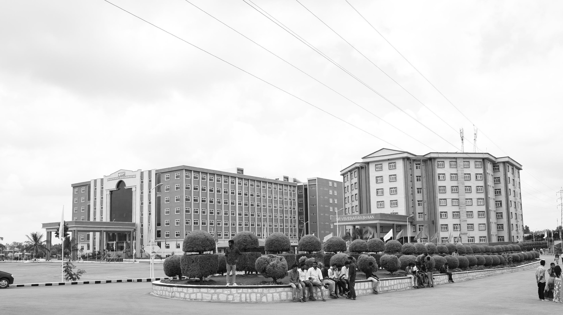

Design and Development of Self-Heating and Cooling Materials in Wiring Harnesses
AY 2021-25
GITAM UNIVERSITY
Major Project
Project ID: C4
A University should be a place of light, of liberty, and of learning.
Department of Electrical Electronics and Communication Engineering
Project Team:-
G. Narendra – BU21EECE0100166
Kula Shekhar Reddy – BU21EECE0100384
K. Sai Jeevan – BU21EECE0100202
Project Mentor:
Dr. C. Kamalanathan
Associate Professor/EECE
www.gitamedu.com

Slide 2




Project Group – Details
Photo
Track
Roll No
Name
EECE
BU21EECE0100166
Gali. Narendra
Photo
EECE
BU21EECE0100202
K. Sai Jeevan
Photo
EECE
BU21EECE0100384
G. Kula Shekhar Reddy

Slide 3
Objective and Goals
Objective
To identify the self-heating and cooling materials for wiring harnesses
To enhance the safety, reliability, and efficiency of electrical systems.
To optimize the power consumption in the proposed system.
Goals
Enhance Safety: Develop materials that regulate temperature to prevent overheating, electrical failures, and fires in wiring harnesses.
Improve Reliability: Increase electrical systems' durability and consistent performance by protecting wiring harnesses from environmental damage.
Boost Efficiency: Optimize energy use and reduce maintenance needs through advanced self-heating and cooling materials.
Innovate Material Design: Create and integrate new materials that set a new standard for temperature control in wiring harnesses.
Safety: Material to avoid overheating and over-cooling

Slide 4
Sl. No | Title | Author & Year | Methodology | Drawbacks | Link
1. | Development of High Strength Aluminium Wires for Low-Voltage Automotive Wiring Harnesses | 2017 Kinji Taguchi, MisatoKusakari, Yasuhiro Akasofu, Jun Yoshimoto | Alloy Design Heat Treatment Manufacturing Process Testing | →Long-Term Reliability in extreme conditions: Further research might be needed to assess long-term durability | Link
2. | High-Strength Aluminum Wires for Low-Voltage Automotive Engine Wiring Harnesses | 2017 Kinji Taguchi Takanobu Shimada Jun Shimada Tetsuya Kuwa bara Yasuhiro Akasofu | →High-Strength Aluminium Alloy Development →Aging heat treatment →Crimping Technology →Wire Manufacturing Process | → Lower Electrical Conductivity → implementation costs → Compatibility with existing components | https://global-sei.com/technology/tr/bn84/pdf/84-22.pdf

Slide 5
Identified materials
Aluminium Alloy wires: Aluminum alloys are significantly cheaper and lighter than copper while offering moderate conductivity
Silicon Rubber: Silicon rubber offers high heat resistance (up to 250°C) and flexibility at an affordable price
Glass Fiber Sleeves: Glass fiber sleeves offer robust heat resistance and mechanical protection, making them an affordable yet advanced solution for protecting wiring harnesses in harsh environments.
Fluoropolymers: Fluoropolymers offer excellent insulation and high thermal resistance, reducing the risk of electrical failures caused by heat or chemical exposure.

Slide 6
1. Aluminum Alloy Wires vs. Copper Wires
Aspect | Aluminum Alloy Wires | Copper Wires
Cost | Significantly cheaper | Expensive
Weight | Lighter(by ~50%) | Heavier
Conductivity | Moderate(60-70% of copper’s conductivity) | Excellent(high conductivity)
Corrosion Resistance | Lower, prone to oxidation, but can be improved with coating | Higher, natural corrosion-resistant
Mechanical Strength | Lower tensile strength | Higher tensile strength
Flexibility | More brittle | More ductile and flexible
Advantages of Aluminum Alloy Wires:
Cost-effective for large-scale applications where reducing material costs is crucial.
Lighter weight helps reduce overall vehicle/equipment weight, enhancing fuel efficiency in automotive applications.
Suitable where moderate conductivity is acceptable, especially in high-volume wiring systems.

Slide 7
2. Silicon Rubber vs. PVC Insulation
Aspect | Silicon Rubber | PVC Insulation
Heat Resistance | High (up to 250°C) | Moderate (up to 105°C)
Flexibility | Excellent, remains flexible at low and high temperatures | Good, but stiffens at low temperature
Durability | High, resistant to aging and weathering | Moderate, prone to cracking over time
Cost | Affordable for high-performance applications | Cheaper
Chemical Resistance | Good | Moderate
Advantages of Silicon Rubber:
High-temperature resistance makes it ideal for environments with extreme heat exposure, such as automotive or industrial machinery.
Flexibility across various temperatures ensures durability in hot and cold climates.
Offers greater longevity compared to PVC, especially in harsh conditions.

Slide 8
3. Glass Fiber Sleeves vs. Braided Sleeving
Aspect | Glass Fiber Sleeves | Braided Sleeving
Heat Resistance | Very high (up to 650°C) | Lower, varies by material (typically up to 200°C)
Mechanical Protection | Excellent, protects against abrasion, compression | Good, offers moderate protection
Cost | Moderate | Affordable
Application | Ideal for high-temperature or heavy-duty environments | Suitable for general-purpose applications
Advantages of Glass Fiber Sleeves:
Superior heat resistance makes them ideal for harsh environments, including aerospace, automotive, and high-performance industries.
Provides better mechanical protection, safeguarding the wiring from external damage like abrasion, crushing, and high temperatures.

Slide 9
4. Fluoropolymers vs. Traditional Insulation Materials (like PVC)
Aspect | Fluoropolymers (e.g., PTFE) | PVC Insulation
Chemical Resistance | Excellent, resistant to chemicals, oils, acids | Limited, vulnerable to chemical exposure
Heat Resistance | Extremely high (up to 260°C) | Moderate (up to 105°C)
Dielectric Properties | Excellent insulation and dielectric strength | Good dielectric properties
Cost | Expensive | Cheaper
Advantages of Fluoropolymers:
Exceptional heat resistance and chemical stability make them ideal for high-performance and high-risk environments.
Reduces the risk of electrical failure caused by extreme heat or chemical exposure, making them perfect for specialized applications like aerospace, defense, and automotive sectors.

Slide 10

Process of selecting Materials for wiring harness
1. Define Performance Requirements
2. Evaluate Existing Material Options
3. Analyse Material Properties
4. Compliance with Standards and Regulations
5. Prototyping and Testing
6. Cost and Availability
7. Final Selection

Slide 11
1. Define Performance Requirements
Thermal Requirements: Define the operating temperature range, and assess the need for thermal regulation (self-heating/cooling). Materials must withstand extreme heat without degrading.
Mechanical Requirements: Consider flexibility, tensile strength, and resistance to mechanical stresses like vibrations and bending.
Electrical Properties: Ensure proper conductivity, insulation, and resistance to electrical stress. The material must prevent electrical shorts, leaks, and fires.
Environmental Conditions: Assess the material's resistance to moisture, chemicals, and corrosion, as the harness will be exposed to a variety of environmental factors.

Slide 12
2. Evaluate Existing Material Options
Polymers: Common in wiring insulation due to their flexibility and resistance to heat. Examples include PVC (Polyvinyl chloride), PE (Polyethylene), and PTFE (Teflon). In advanced applications, materials like Fluoropolymers and Elastomers are used for higher heat and chemical resistance.
Metals: For conductors, Copper and Aluminum are widely used due to their high conductivity. Copper is typically preferred for its superior electrical properties, but aluminum is lighter and sometimes chosen to reduce weight in large systems.
Advanced Materials: For self-heating and cooling functionality, materials like Phase Change Materials (PCMs) and Shape Memory Alloys (SMAs) may be considered. These materials help manage thermal conditions by either absorbing or dissipating heat as needed.

Slide 13
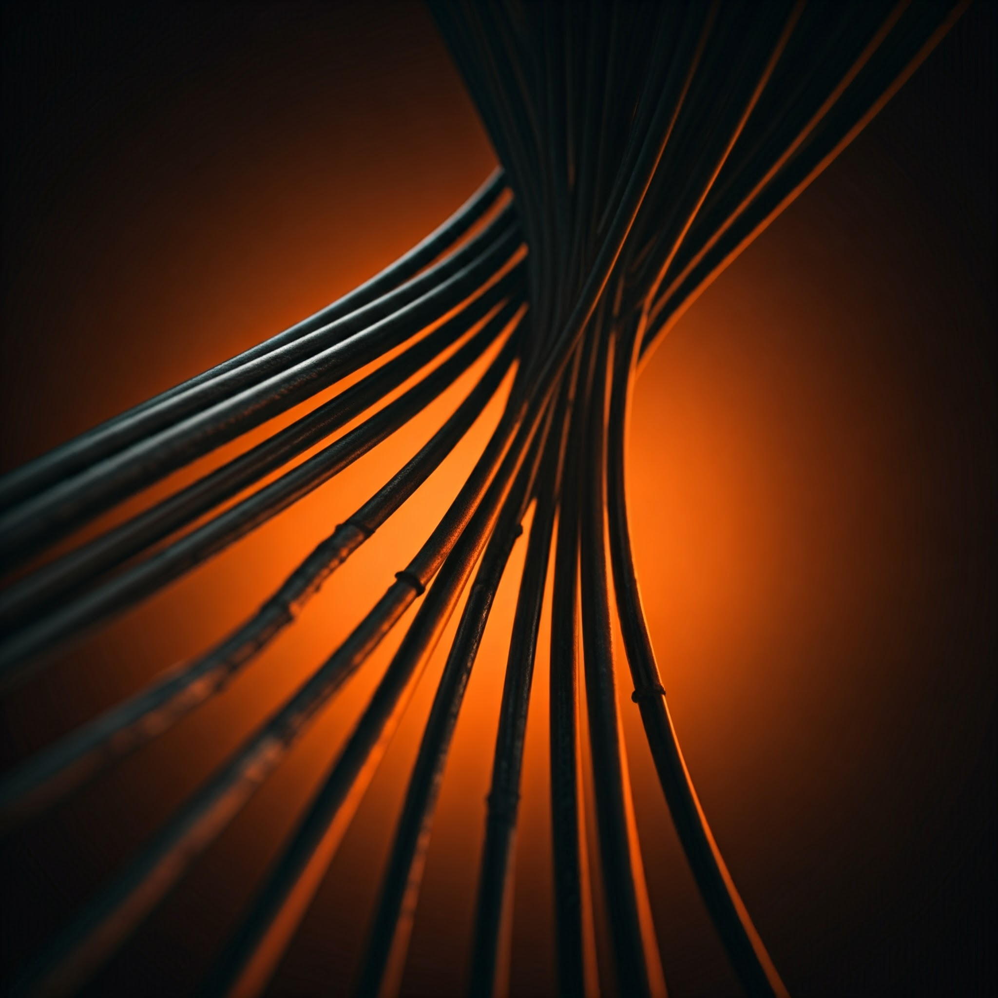
3. Analyze Material Properties
Thermal Conductivity: The material should either dissipate or store heat effectively depending on the design requirements. High thermal conductivity helps prevent overheating.
Electrical Insulation: Insulation materials need to have excellent dielectric properties to protect the wires and prevent electrical leaks or shorts.
Durability and Longevity: Materials should resist wear and tear over time, maintaining performance for years, especially since wiring harnesses are expected to last for long periods (often 20 years or more).
Weight: For automotive applications, reducing the weight of the wiring harness is crucial for overall vehicle efficiency.

Slide 14
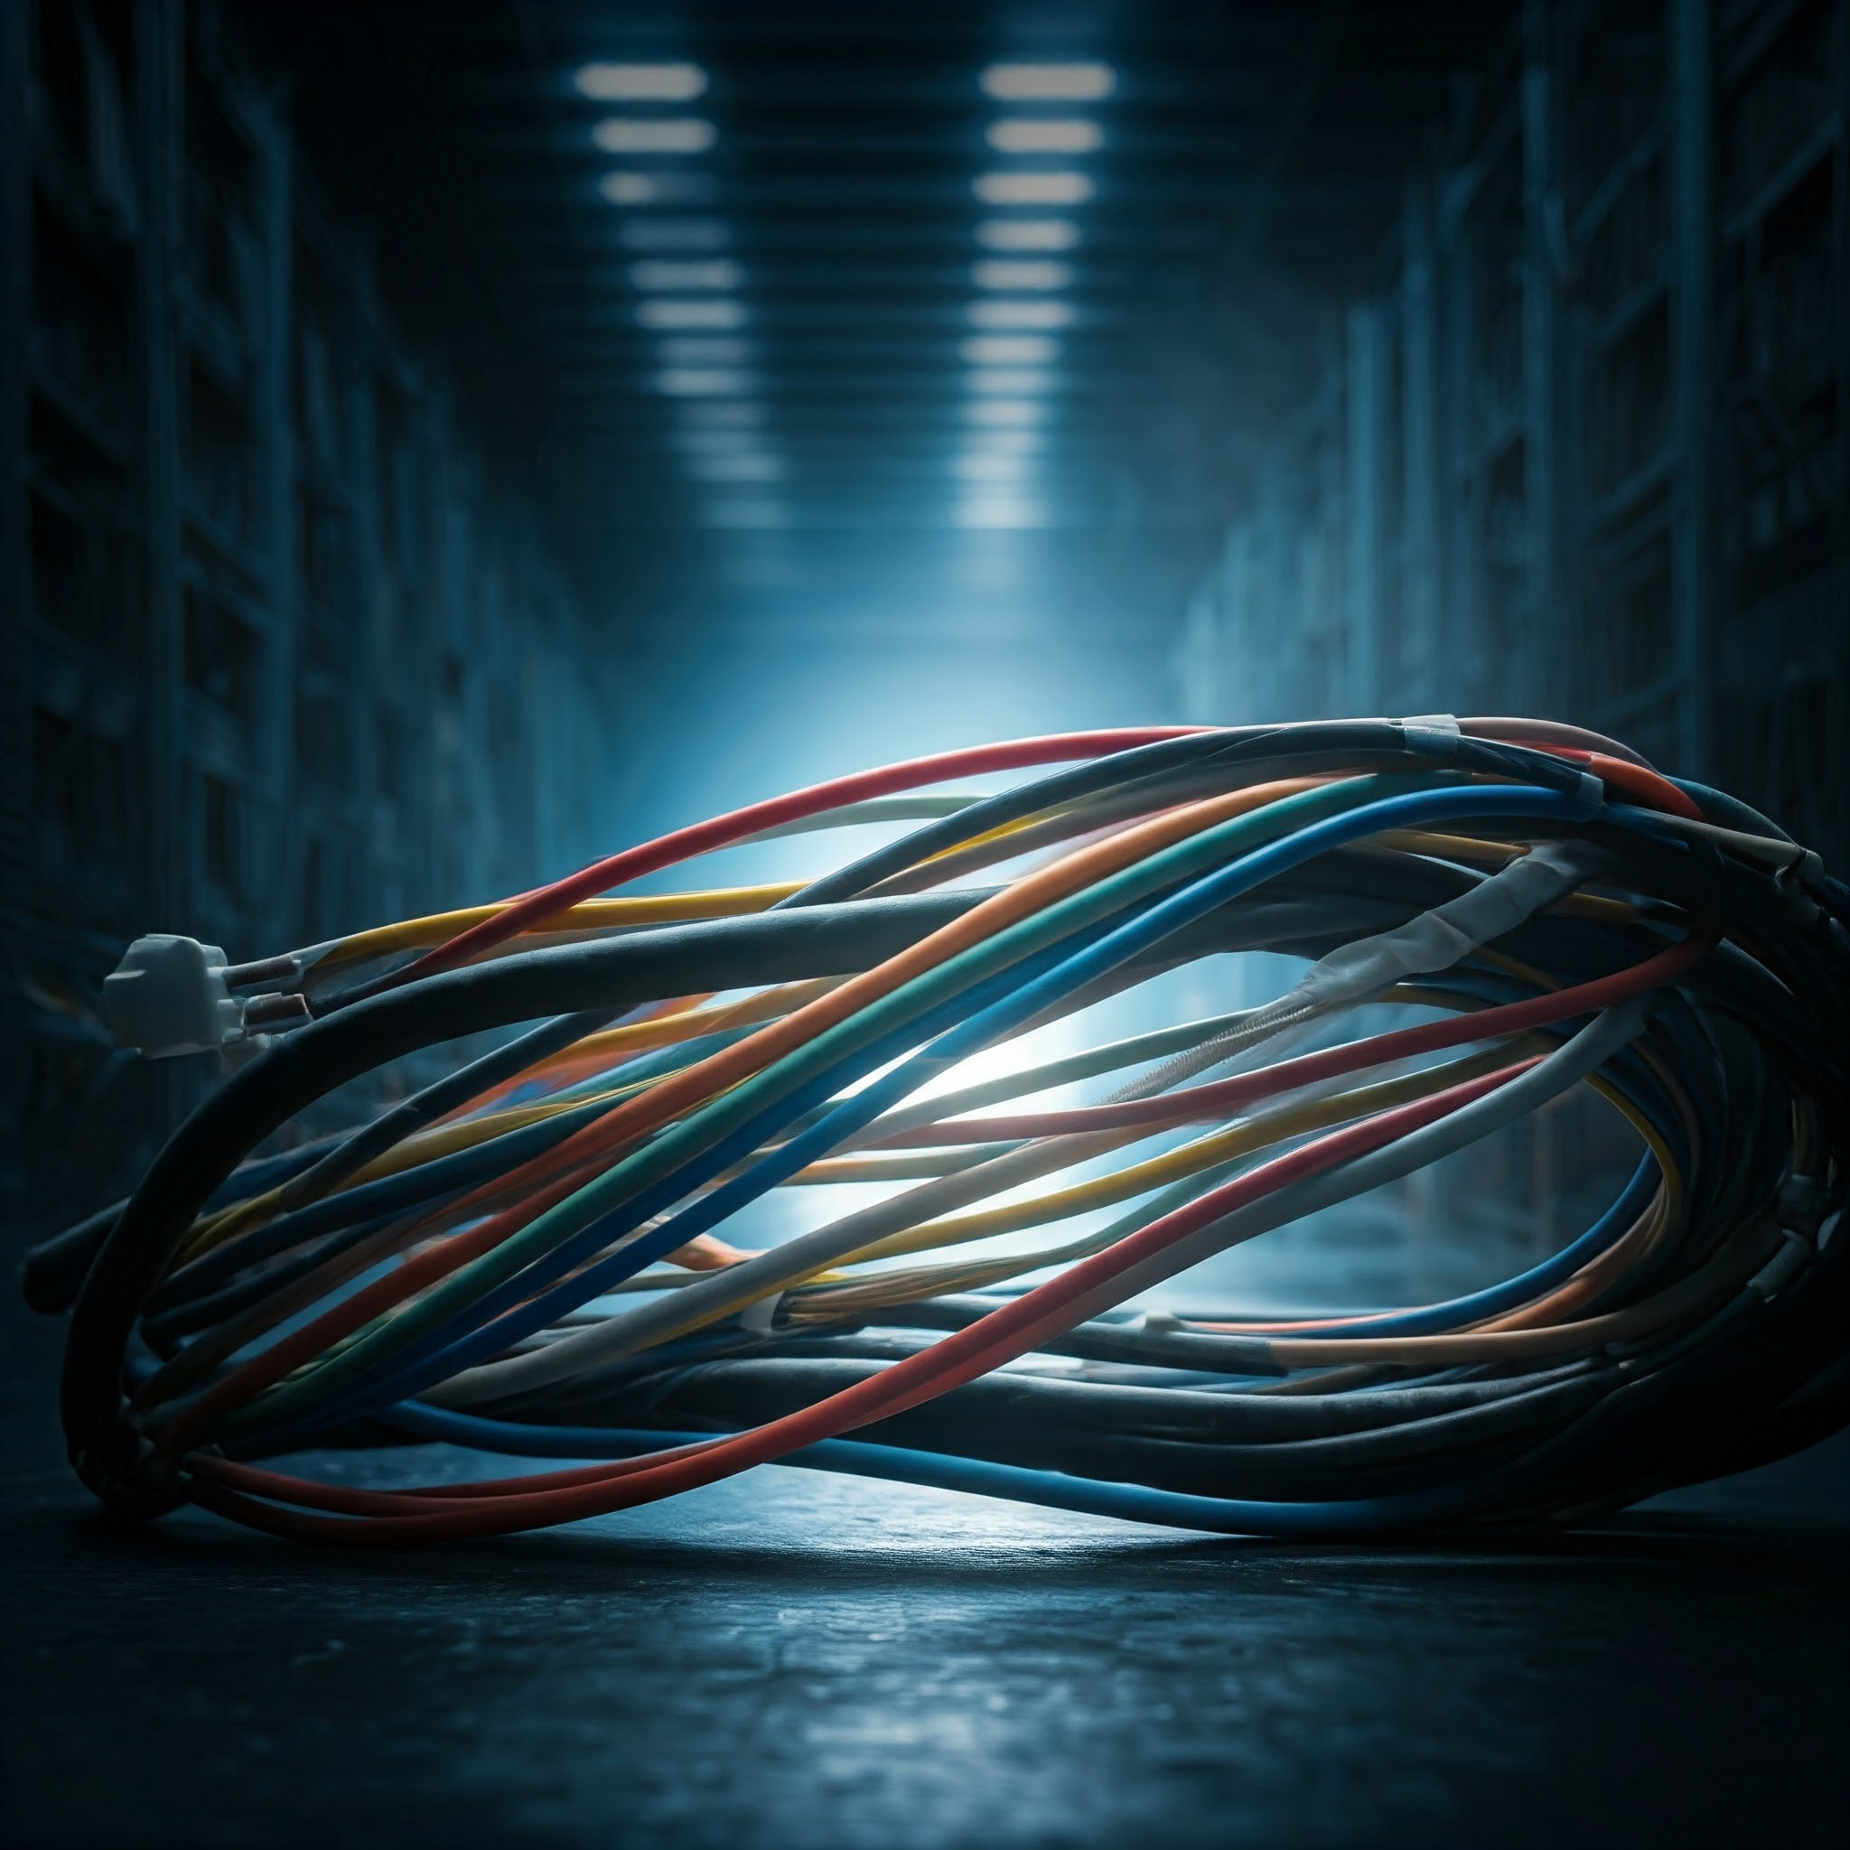
4. Compliance with Standards and Regulations
Environmental Regulations: The materials selected must meet global standards (e.g., RoHS – Restriction of Hazardous Substances) to ensure they do not contain harmful chemicals. This is important for environmental sustainability and legal compliance.
Safety Standards: Materials need to comply with industry-specific safety standards like UL (Underwriters Laboratories) and ISO (International Standards Organization), particularly for fire resistance, flammability, and electrical insulation properties.

Slide 15
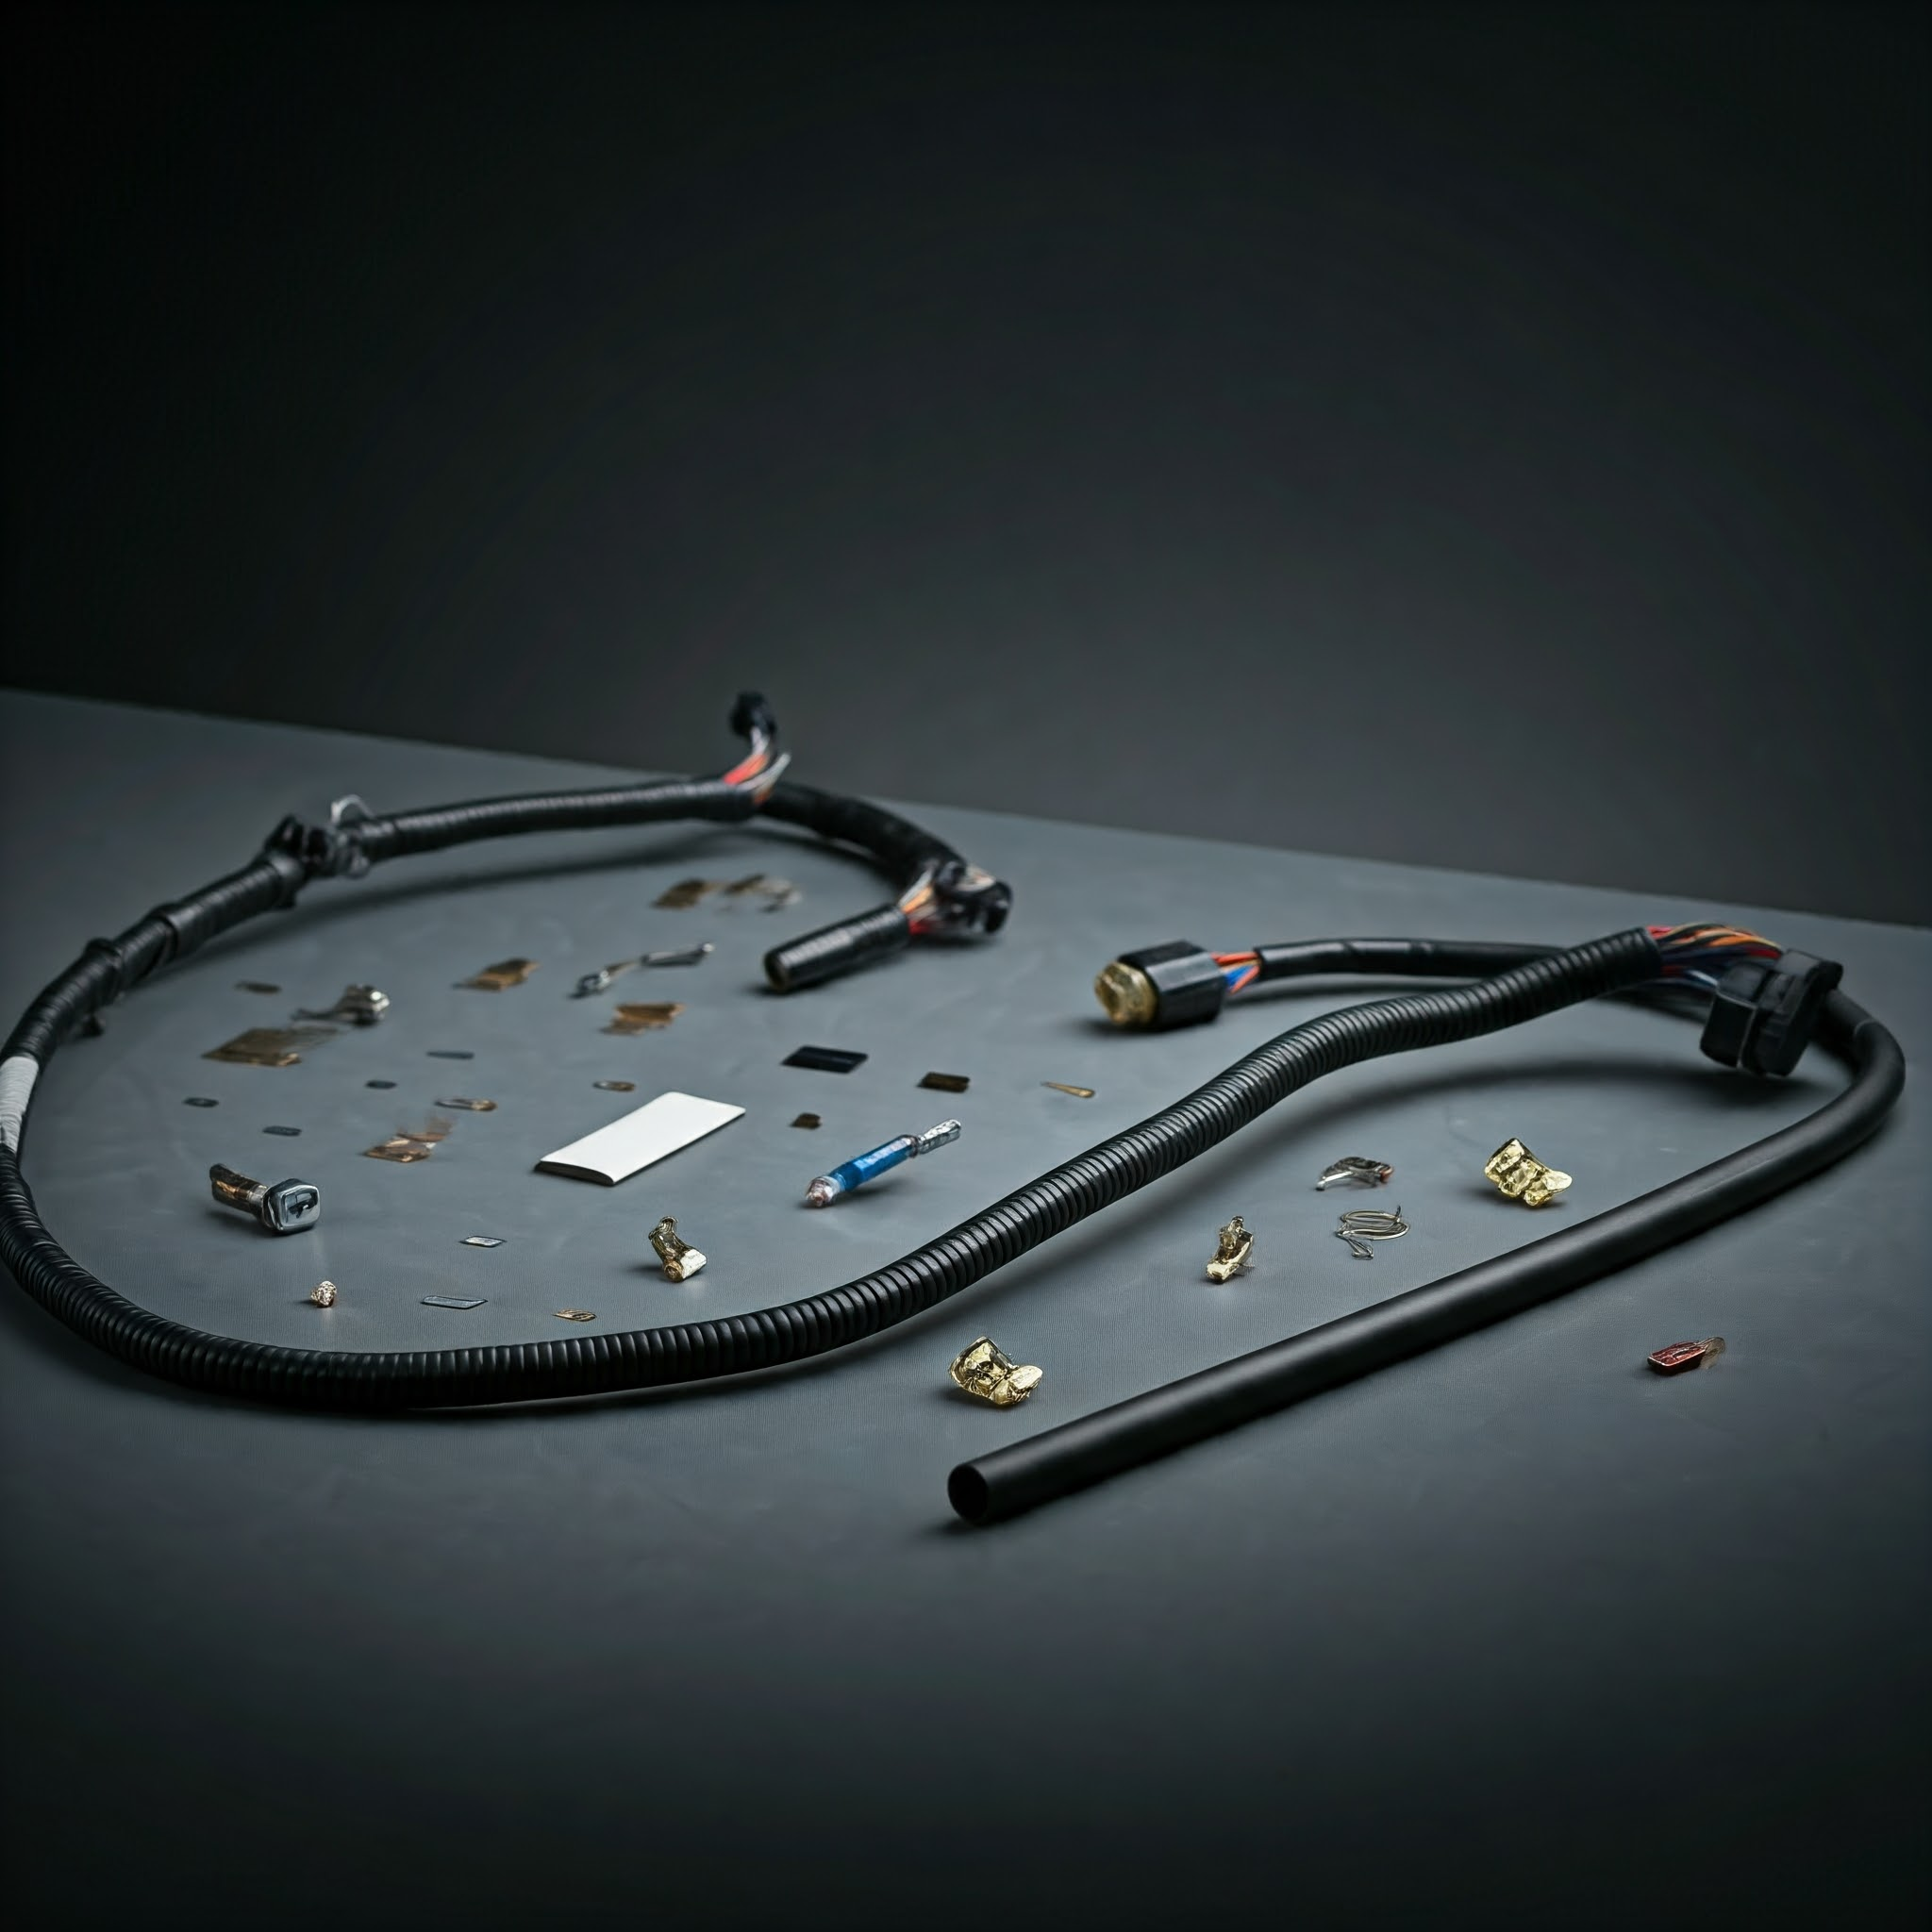
5. Prototype and Testing
After selecting potential materials, create a prototype of the wiring harness.
Thermal Testing: Ensure that the material performs well under simulated operating temperatures and stress conditions.
Mechanical Testing: Assess how the material reacts to physical stresses like bending, stretching, and vibration.
Electrical Testing: Conduct tests for conductivity, insulation, and resistance under different load conditions.
Environmental Testing: Expose the material to moisture, chemicals, and corrosion to verify its durability in real-world conditions.

Slide 16
6. Cost and Availability
Consider the cost of materials and their availability for large-scale production. Some advanced materials, such as SMAs or PCMs, may be more expensive or harder to source in bulk, affecting project feasibility.

Slide 17
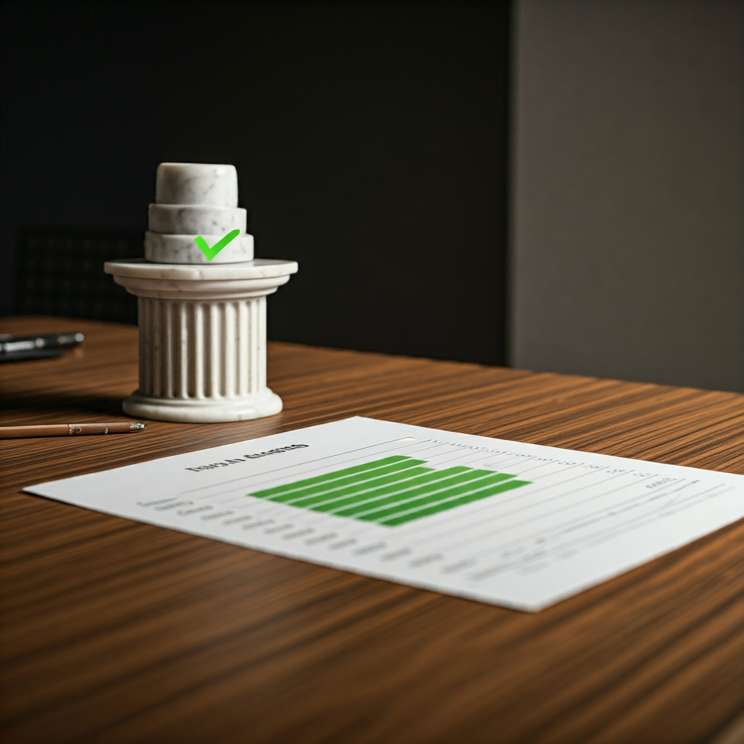
7. Final Selection
Based on the results of performance testing, cost analysis, and compliance checks, the final materials are selected.
Ensure that the chosen materials offer the best balance between performance, safety, durability, and cost for the specific application (self-heating/cooling in wiring harnesses)

Slide 18
Software tools used for wiring harnesses
CATIA5 SOFTWARE
AUTOCAD SOFTWARE
HARNWARE SOFTWARE
RAPID HARNESSES
SOLIDWORKS SOFTWARE

Slide 19

RAPIDHARNESS
RapidHarness is a software tool designed for the fast and efficient design of wiring harnesses, particularly for industries like automotive, aerospace, and industrial equipment. It streamlines the complex process of wiring harness design, allowing engineers to create, simulate, and test harnesses more effectively

Slide 20
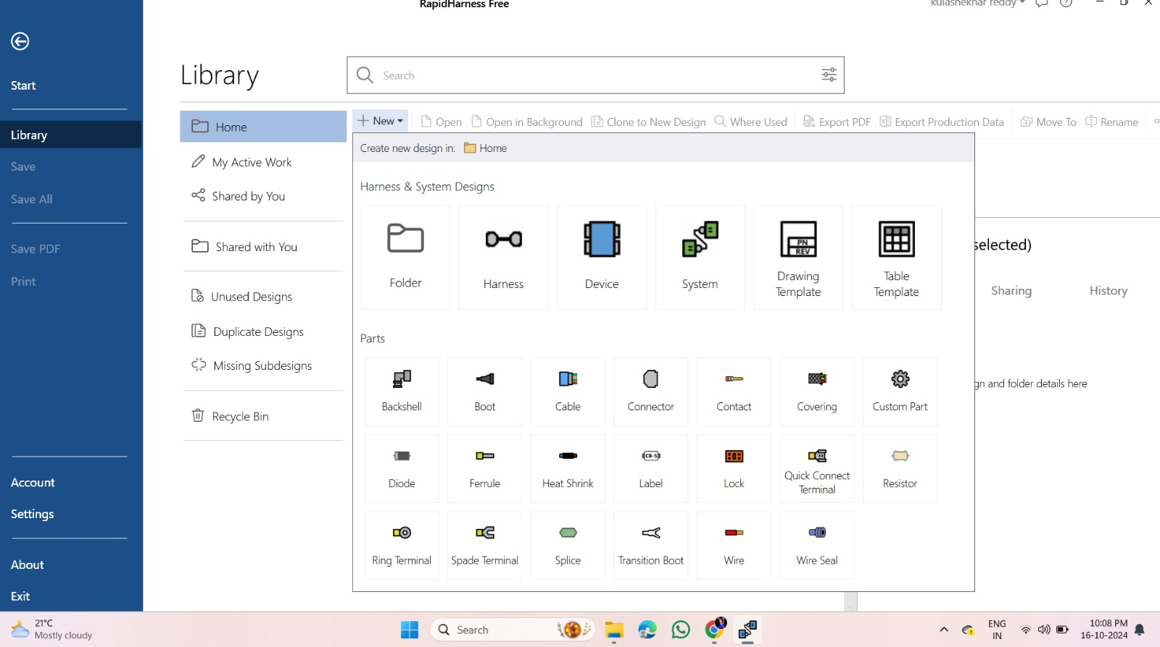
Features
This image shows the RapidHarness Free software interface, specifically the Library section, which allows users to create new designs or access previously shared or saved work. The interface displays several important categories:

Slide 21
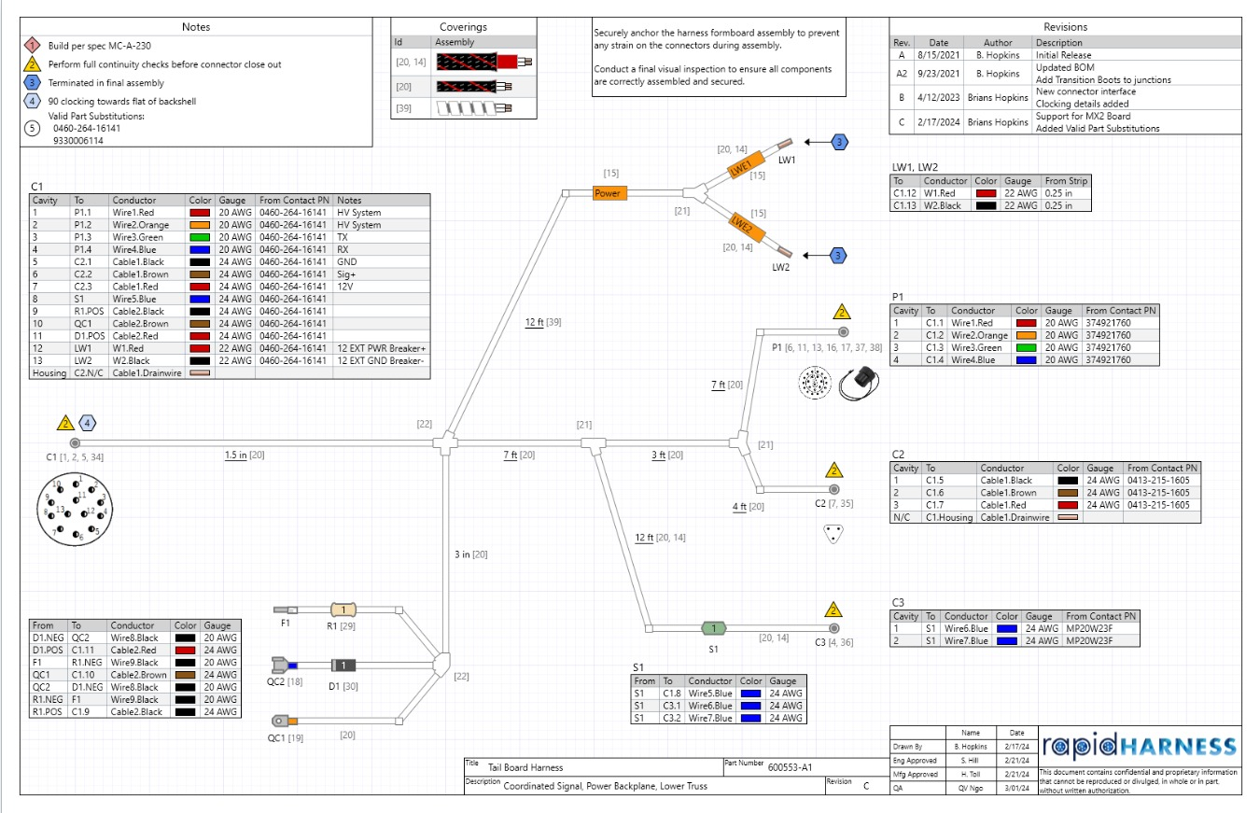

Slide 22
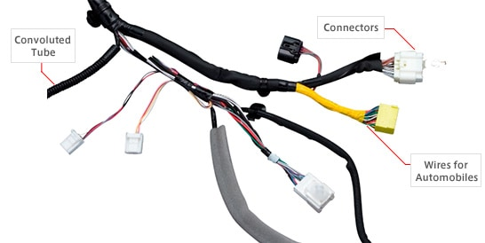
Hardware components
Connectors
Terminals
Flagged terminals
Butt terminals
Grommets
Sheath, conductor, and insulation material

Slide 23
Conclusion:
"The Design and Development of Self-Heating and Cooling Materials in Wiring Harness project addressed some challenges associated with traditional wiring harnesses. By integrating innovative self-heating and cooling materials, we want to develop a wiring harness system that regulates temperature and significantly enhances electrical systems' overall safety and reliability.
Our approach involved careful material selection, advanced thermal management techniques, and rigorous testing to ensure the harnesses' performance in diverse environmental conditions. The resulting self-regulating wiring harnesses demonstrated substantial improvements in preventing overheating, reducing the risk of electrical failures, and mitigating potential hazards such as short circuits and fires.
This technology has the potential to revolutionize various industries, including automotive, aerospace, and electronics. Future research could further optimize material properties, develop more efficient thermal management strategies, and explore new applications for self-regulating wiring harnesses."

